Slide 1


Wealth Building Class
Tax Strategy

Slide 2
Your Tax Expert is Crucial
Keep more in your pocket by properly coordinating with your planner, investment specialist and tax expert.
Certified Public Accountants (CPA’s) specialize in tax reporting.
If you do your own taxes, have a tax expert you can call because your investment, planning, insurance, banking and business specialists usually are not.

Slide 3
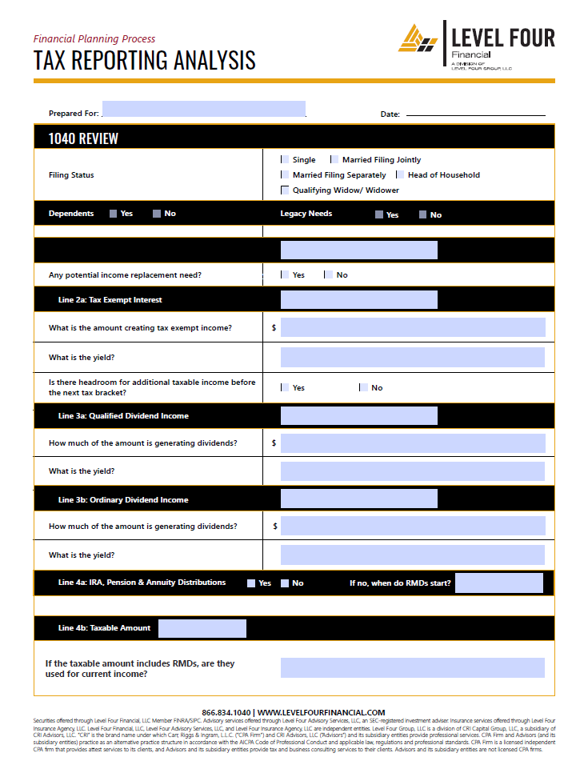
Understand Your 1040
CPAs are experts at explaining what happened last year and what to consider this year.
Use the information from your tax return to identify risks and opportunities for short, intermediate and long term planning.
Tax savings can help fund goals including immediate lifestyle.

Slide 4
Tax Harvesting
Volatility is an opportunity.
Sell a loss, buy similar holdings.
  If an index fund is at a loss, buy another company’s version of the same index.
  If an actively managed large cap fund is at a loss, consider another large cap fund.

Slide 5
Winter is Coming
Mutual Funds often have year end dividends and capital gains.
Realizing losses can help offset in the same year.
Carry Forward losses are usually held to $3k per year thereafter.

Slide 6
Maximizing Charitable Deductions
Tax breaks for those who give to 501(c)3 groups
Can help offset large taxable liquidation events
Lifetime and Legacy opportunities
  Donor Advised Funds (DAF)
  Foundations
  Qualified Charitable Distribution (QCD)

Slide 7
New Rules
Change seems to be the primary constant regarding taxes.
Your tax, investment, insurance, estate and planning specialists should all be on the same page.
If you do not maximize the opportunity, the Uncle Sam probably will.

Slide 8
Advisory services offered through Level Four Advisory Services, LLC, an SEC-registered investment adviser.

