Slide 1


Wealth Building Class
Organize

Slide 2
Ideal 4 Step Process
Emergency Reserve
Squash short & intermediate debt
Save for goals
Eliminate long term debt

Slide 3
Set up your Personal Financial Website
eMoney
Money Guide Pro
Quicken
Mint
Every Dollar

Slide 4
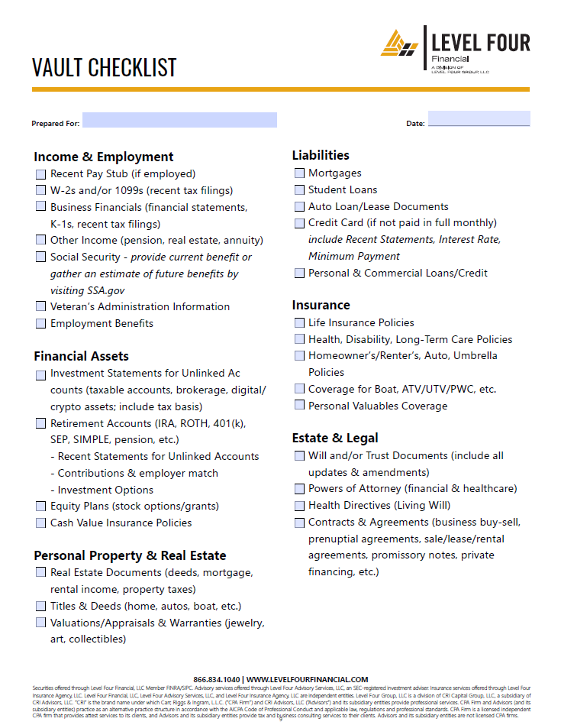
Gather Documents
Use your secure digital vault to upload documents so you and your professional team can access them safely, allowing your trusted people to have current records when addressing your financial needs.
Anyone who has power to make decisions or needs access to data to help you make decisions should be able to access relevant documents securely.

Slide 5
Link Accounts or Begin Manual Entry
Linking accounts allows your Personal Financial Website to update data for you daily so whenever you view your information it can be current.
If an account does not have a website through the record keeper (your bank, brokerage firm, insurance company, etc.), manually input information and commit to regular updates so your Personal Financial Website has relevant information when you need to make a decision.

Slide 6
Monitor the Personal Financial Website
Whether you do it yourself or have a professional team handle it, monthly maintenance is essential.
Make sure links are active
Update balances and positions/asset mix for manually added accounts
Update property and real estate details regularly
Keep your vault organized and link documents to relevant property, real estate and accounts

Slide 7
Annual, Semi-Annual or Quarterly Topics
Investment Strategy – Have a written Investment Policy Statement
Asset Allocation – Is your portfolio within a prudent range of your written strategy?
Retirement Strategy – is your retirement growth strategy likely to succeed? If you are drawing retirement income, are you likely to have enough for life?
Other Goal Strategies – Is the amount of risk appropriate given your time, comfort levels, and amount of money invested?
Watch the Watchers – Using your written Investment Policy Statement and Asset Allocation reports, Is the portfolio invested appropriately now? If you see more than 5% in any position or more than 5% variance of your stated market exposure target, ask why so you can decide if you agree with logic and feel comfortable with the level of risk.

Slide 8
More Clarity Leads to Less Stress
Knowing is half the battle.
See the field clearly so you can logically decide the next step.
If you are not an expert in a particular subject, ask an expert.
Investment performance is important, and many other components are equally important.
When a household understands how all the pieces fit together, peace of mind is often increased.

Slide 9
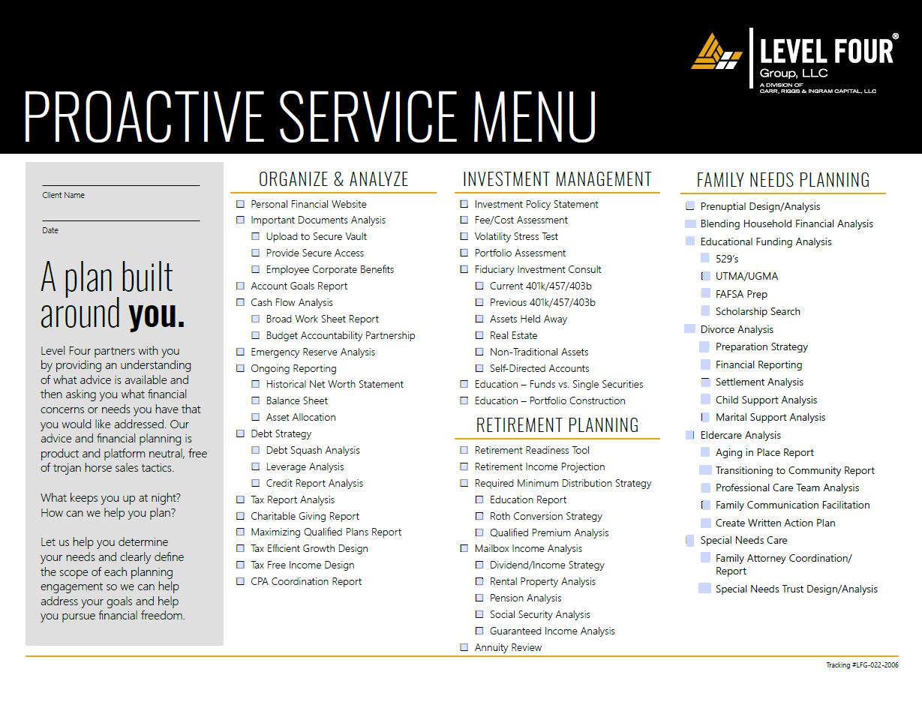

Slide 10
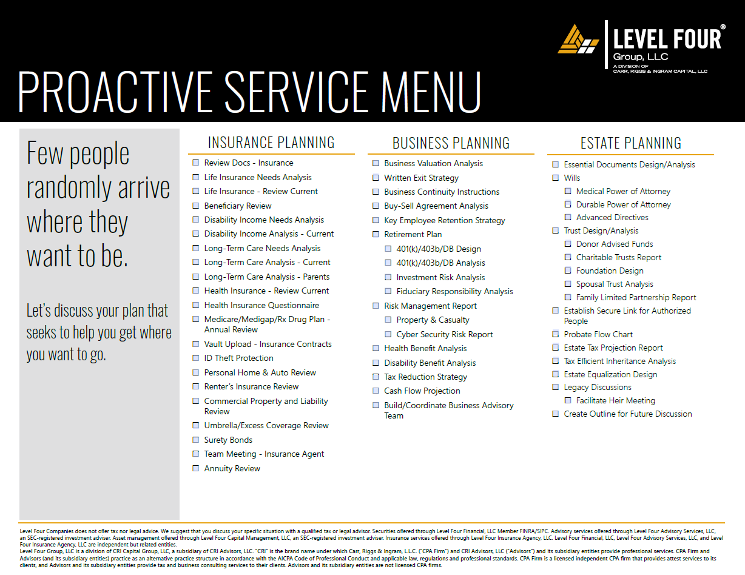

Slide 11
Assemble your team of Experts
If you already have a team, call a meeting to open lines of communication.
If you have any gaps or need to build a team from scratch, we can help.
No one can be a specialist in every area.
A team of experts will provide superior advice vs. a generalist who pretend to know everything.
Generalists provide advice that is an inch deep and a mile wide.
An expert team of specialists provide advice that is a mile deep and wide.
When your financial world is no longer stuck in your mind and is viewable in one location, your team can work together to do what they do best for your benefit.
Know when to ask questions and who to ask.

Slide 12
Advisory services offered through Level Four Advisory Services, LLC, an SEC-registered investment adviser.

