Slide 1


Wealth Building Class
Budgeting

Slide 2
Control Your Money or Your Money Will Control You
Know what every dollar will do before it gets into your hand
Money without a purpose almost always flies away
When you own your numbers, you will control your cash flow rather than reacting to your bills

Slide 3
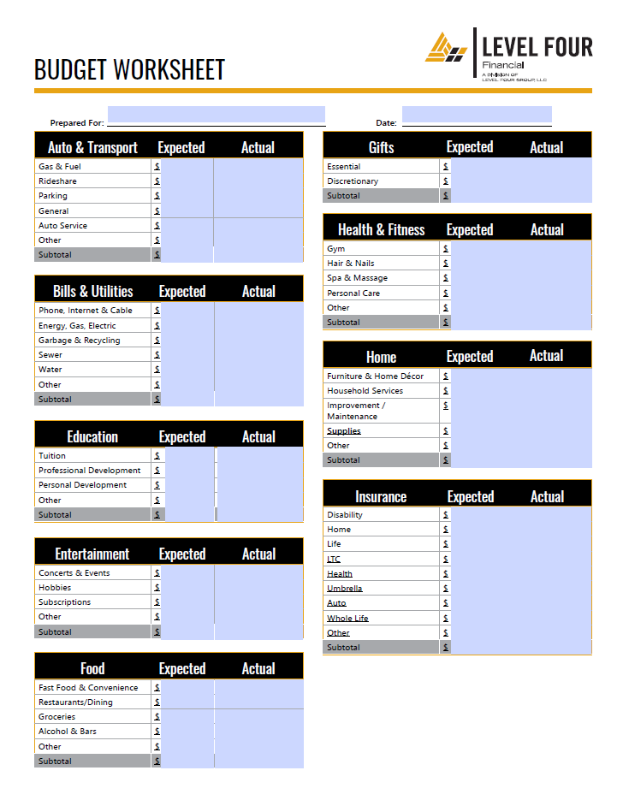
Put It On Paper
Start with what you think you spend
Pull your statements to see what you actually spent
No judgement: we are looking at the past which cannot be changed to determine what you want to adjust in the present which will change your future

Slide 4
Online Tools
Level Four Personal Financial Website
Quicken, Mint, Every Dollar, etc.
Whichever site you use, it should pull each transaction for you automatically

Slide 5
Set Rules/Parameters
Organize the data pulled into the site
    Start with the past 30 days
    Pull back to 90 days
    Pull back to YTD
Setting rules will organize past transactions and assign future transactions to the category you choose
Rules can be based on dollar amount, a dollar range, specific dates and/or date ranges
Set rules so you have confidence in your category numbers

Slide 6
Create First Budget Draft
Once you know what you spent historically, decide if you want to spend less, the same or more this month
If you opt to spend less on a category, consider a 10% reduction rather than a deeper cut
      Too much change too fast feels like a fiscal diet
      If you spend even less than 10%, you’ll likely feel good
      You can cut another 10% next month if you stay within your goal
Track weekly for the first 3 months
Track monthly after 3 months
It is probable you’ll need to adjust multiple times before you find your true numbers

Slide 7
Commit to an Accountability Partner
For married couples working together, be each other’s accountability partner
    No judgement when looking at the past
    Be gracious with each other
    Seek an objective 3rd party if needed
Accountability Meetings
    Weekly for the first 12 weeks
    Monthly thereafter
Dynamic rather than static
Life Habits rather than Fiscal Diet

Slide 8
It’s Your Money
There is no formula that fits every household
Consider 30% or less as a target for housing cost
Consider debt squash strategies to free up more monthly cash flow to spend as you wish
Cover essential costs (housing, food, servicing debt if you have it)
Decide what brings you joy and put your money where your mouth is
Give me your calendar and your bank/card statement and it’ll tell you what is important in your life
Money is a tool; use it wisely and you can achieve great things

Slide 9
Advisory services offered through Level Four Advisory Services, LLC, an SEC-registered investment adviser.

